Slide 1

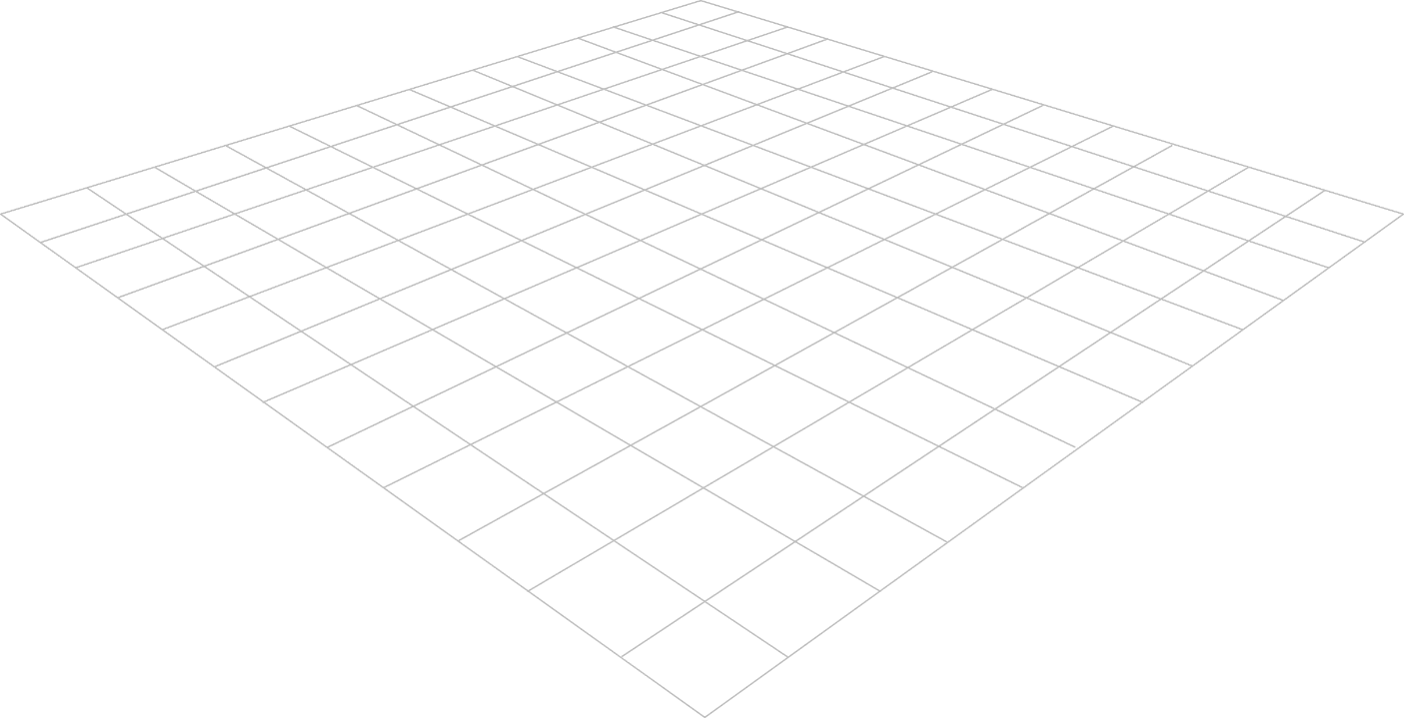
Measurement of Growth and Development
Growth Chart
Third Stage
Dr. Moustafa Alshammari
Growth and Developments

Slide 2
Learning objectives
Define a growth chart and explain why a pattern over time matters more than a single point.
Select the correct chart by age and sex (boys and girls; WHO and CDC).
Explain the difference between a growth standard (WHO) and a growth reference (CDC).
Measure weight, length/stature and head circumference accurately.
Plot, read and interpret percentiles using the correct cut-offs.
Apply the nursing process: act on findings, document, educate parents, refer.
2
Notes:
Objectives map to the sections that follow.

Slide 3
Growth Charts
Growth charts use a series of percentile curves to demonstrate the distribution of body measurements in children.
Notes:
Plot on Percentile Charts: You plot these measurements on percentile charts, which are graphs that display a range of values from the lowest (0th percentile) to the highest (100th percentile). Each percentile line represents a specific percentage of the population. For example, the 50th percentile represents the median or middle value for the general population.
Comparison: By plotting a child's measurements on these charts, you can see where their measurements fall in relation to the general population. For instance, if a child's height measurement is on the 75th percentile line, it means that their height is greater than or equal to 75% of children in the reference population.
Interpretation: The interpretation of these percentile measurements depends on the specific parameter being assessed. For example, if a child consistently falls below the 5th percentile for weight, it might indicate underweight or slow growth, while measurements consistently above the 95th percentile might indicate overweight or rapid growth. However, it's essential to consider various factors, including genetics and individual growth patterns, when interpreting percentile data.

Slide 4
Growth Charts
Children who show a sudden increase (except during puberty), decrease, or no change in a previously steady growth pattern
Because growth is a continuous but uneven process, the most reliable evaluation lies in comparing growth measurements over time. It is important to remember that normal growth patterns vary among children the same age

Slide 5
WHO Standards Monitor Infants Under 2 Years While CDC Charts Guide Ages 2 to 20
Assessment Feature | WHO Growth Standards (0 – 2 Years) | CDC Growth Reference (2 – 20 Years)
Target Population | Infants & toddlers from birth to 24 months. | Children and adolescents aged 2 to 20 years.
Biological Standard | Depicts how healthy children SHOULD grow under optimal environmental & feeding conditions. | Depicts how children ACTUALLY grew in the US during reference periods.
Feeding Baseline | Based on predominantly breastfed infants for at least 4 months (optimal feeding standard). | Includes mixed formula and breastfed infants from historical US health surveys.
Clinical Focus | Growth velocity, length-for-age, weight-for-length, and head circumference. | Stature-for-age, weight-for-age, and Body Mass Index (BMI)-for-age.

Slide 6
Growth Percentiles Establish a Child's Relative Position within Reference Norms
Understanding Growth Percentiles
Percentile Definition: A statistical value indicating the percentage of reference children who fall at or below a specific measurement.
50th Percentile: Represents the exact median parameter for age and sex. Half of healthy peers are larger, half are smaller.
Normal Range: Generally defined between the 5th and 95th percentiles on standardized WHO/CDC curves.
Trend vs. Static Value: A single percentile reading is merely a snapshot. Serial measurements over time (the growth curve) are clinically vital.
Clinical Interpretation Example
Key Rule from Wong's Textbook:
"Percentiles are not grades in school. Being in the 10th percentile is not 'worse' than being in the 90th percentile. Consistency along an established trajectory is the primary indicator of normal physical growth."
Case Scenario: 10th Percentile Height
If a 12-month-old boy is in the 10th percentile for length:
• He is taller than 10% of 12-month-old boys.
• 90% of peers are taller than him.
• Clinical Assessment: HEALTHY if he has consistently tracked along the 10th curve since birth.

Slide 7
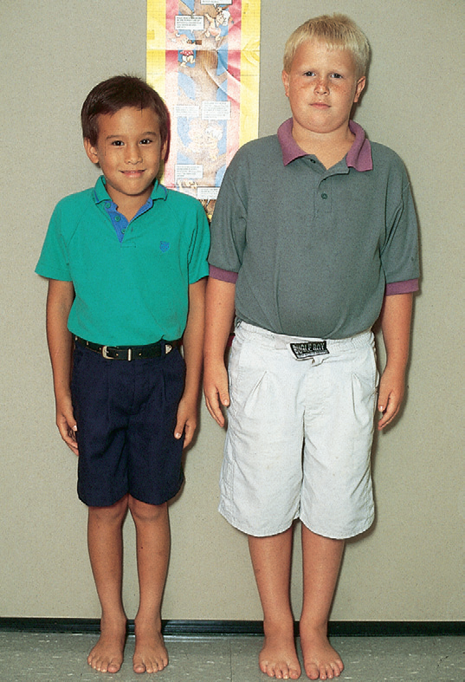
These children of identical age (8 years) are markedly different in size. Child on left, of Asian descent, is at 5th percentile for height and weight. Child on right is above 95th percentile for height and weight. However, both children demonstrate normal growth patterns.

Slide 8
Steps 2–6: select, record, calculate, plot, interpret
2 Select the chart
3 Record data
4 Calculate BMI (≥2 y)
By age and sex; WHO <2 y, CDC ≥2 y.
Parents’ stature, gestational age and birth data (<2 y); date, age, weight and length/stature immediately after measuring; comments.
BMI = kg ÷ cm ÷ cm × 10,000, one decimal place.
5 Plot
6 Interpret
Age rounding
Age on the horizontal axis; draw a vertical line up. Measurement on the vertical axis; draw across. Dot at the intersection. (Weight-for-length: length on the horizontal axis.)
Read the percentile; apply the cut-off for the index; compare with previous visits for major shifts.
<2 y: nearest month. 2–20 y: nearest ¼ year.
Source: CDC (2013) Use and Interpretation of the WHO and CDC Growth Charts, Steps 2–6.
9
Notes:
Age is determined to the nearest month under 2 years and to the nearest quarter-year from 2 to 20 years. BMI = weight (kg) ÷ stature (cm) ÷ stature (cm) × 10,000.

Slide 9
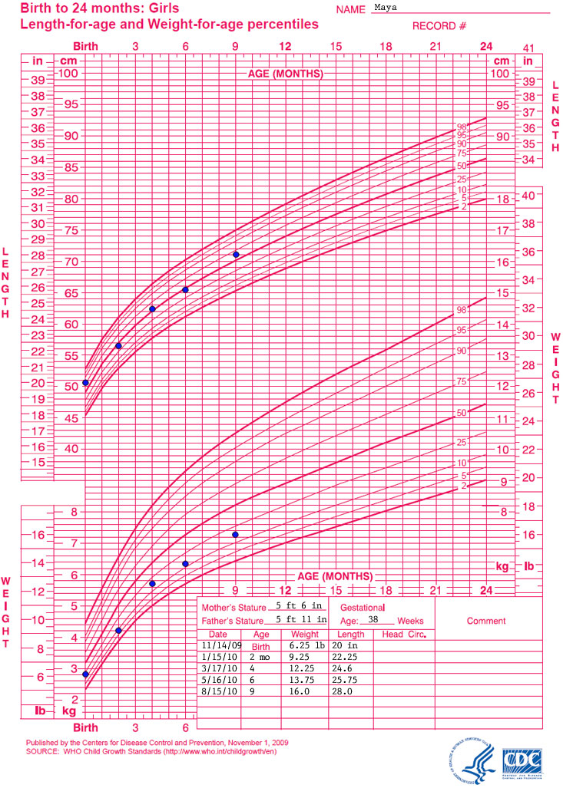
Worked example: plotting a girl’s growth (WHO chart, 0–24 months)
Age | Weight (as charted) | Weight (kg) | Length (as charted) | Length (cm)
Birth | 6.25 lb | 2.84 | 20 in | 50.8
2 months | 9.25 lb | 4.20 | 22.25 in | 56.5
4 months | 12.25 lb | 5.56 | 24.6 in | 62.5
6 months | 13.75 lb | 6.24 | 25.75 in | 65.4
9 months | 16 lb | 7.26 | 28 in | 71.1
Approximate reading: length points lie on or above the 50th curve; weight points lie below the 50th curve.
Each series follows a similar curve over time (tracking).
Next: plot weight-for-length and review feeding before any conclusion.
Chart image: CDC/WHO Birth to 24 months, Girls (CDC training example). Conversions: 1 lb = 0.4536 kg; 1 in = 2.54 cm.
10

Slide 10
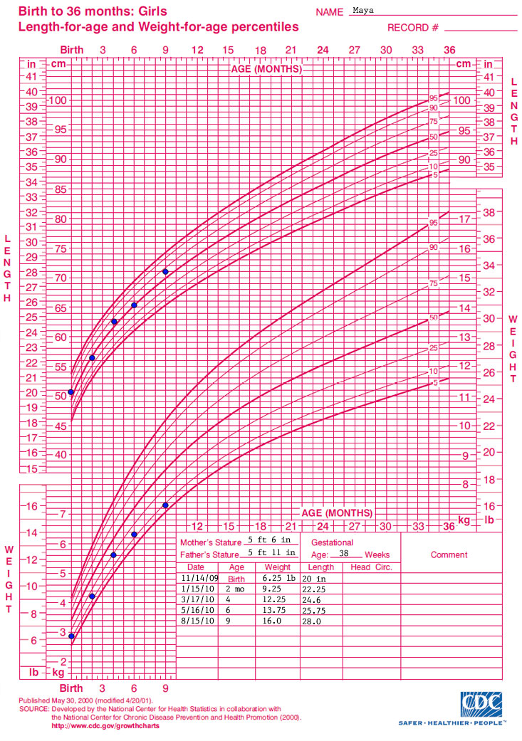

Slide 11
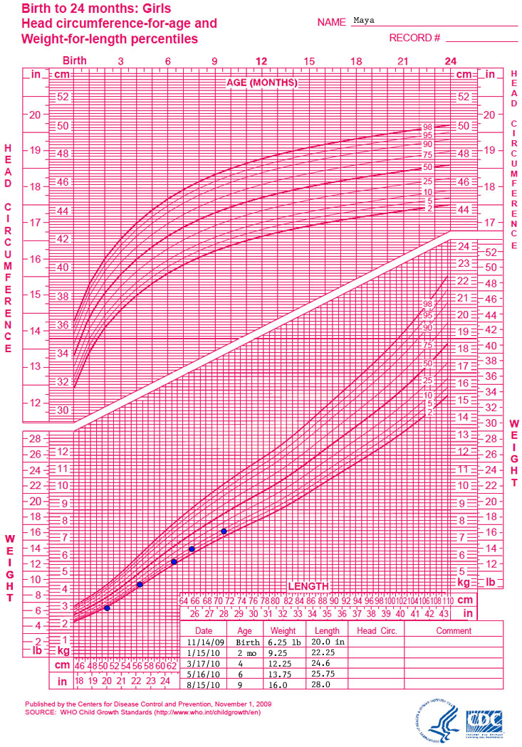
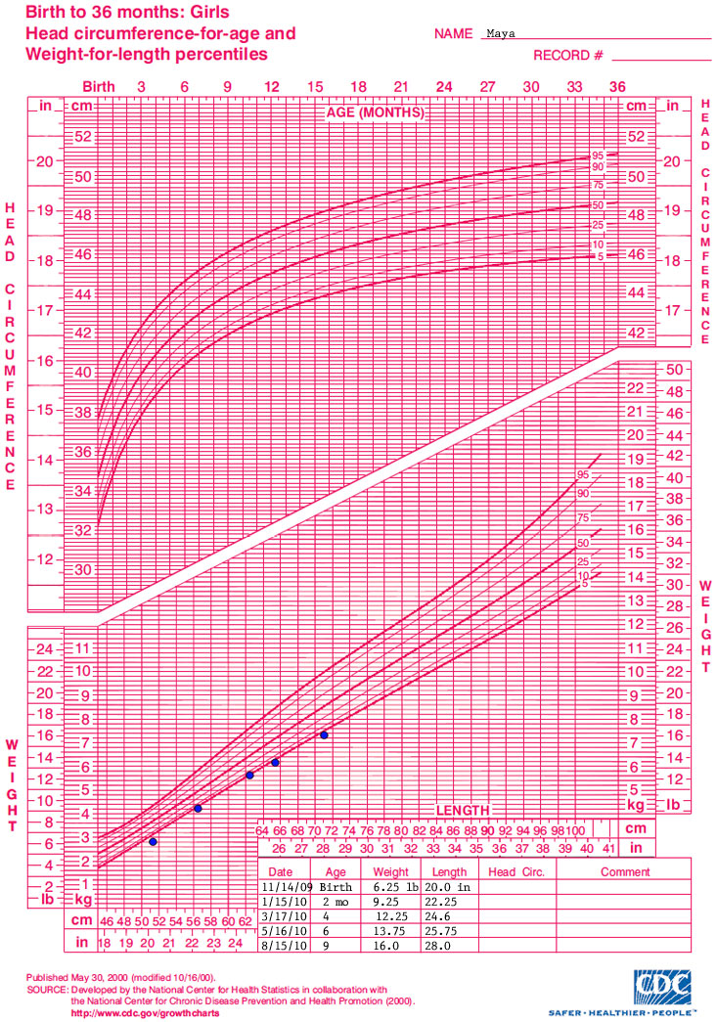

Slide 12
Interpreting the plotted point: cut-offs
Chart set | Index | Percentile | Nutritional indicator
WHO (<2 y) | Length-for-age | < 2nd | Short stature
WHO (<2 y) | Weight-for-length | < 2nd | Low weight-for-length
WHO (<2 y) | Weight-for-length | > 98th | High weight-for-length
CDC (2–19 y) | BMI-for-age | < 5th | Underweight
CDC (2–19 y) | BMI-for-age | 5th to < 85th | Healthy weight
CDC (2–19 y) | BMI-for-age | 85th to < 95th | Overweight
CDC (2–19 y) | BMI-for-age | ≥ 95th | Obesity
CDC (2–19 y) | Stature-for-age | < 5th | Short stature
Source: CDC (2013) guide, Step 6 table. Healthy-weight band (5th to <85th) is the CDC BMI-for-age category. Percentile ranks signal need for monitoring, not diagnosis.
11
Notes:
If the percentile rank indicates a nutrition-related concern, additional monitoring and assessment are recommended (CDC). When transitioning from WHO to CDC charts at 2 years a change in classification may occur; interpret with caution.
A 10-month-old’s length plots below the 2nd percentile on the WHO chart → short stature; assess further.
A 14-month-old’s weight-for-length plots above the 98th → high weight-for-length.
A 5-year-old’s BMI-for-age plots at the 90th percentile → overweight (between the 85th and 95th).
An 8-year-old’s BMI-for-age plots at the 96th → obesity (at or above the 95th).
A 4-year-old’s BMI-for-age plots at the 3rd → underweight (below the 5th).

Slide 13
Growth patterns that need attention
Height and weight percentiles widely disparate (for example, height near the 10th and weight near the 90th).
Failure to follow the expected growth velocity, especially during rapid growth in infancy and adolescence.
A sudden increase (except in puberty), decrease or no change in a previously steady pattern.
A major shift in percentile rank compared with previous visits (CDC).
A plotted point beyond the cut-offs for that index (previous slide).
Before escalating, check
Equipment calibration and technique · correct chart and sex · age (corrected for preterm) · units · parents’ stature, birth weight, gestational age · chronic illness or special health care needs.
Sources: CDC (2013) guide; first three bullets carried over from the original course deck (textbook-based) — verify wording against the textbook page.
12
Notes:
Always recheck measurement technique, chart, sex and corrected age before escalating.

Slide 14
Nursing procedure in health institutions (nursing process)
Phase | Nursing actions
Assessment | Prepare and check equipment; identify the child; explain to the caregiver; measure; collect gestational age, birth weight, feeding history, parents’ stature, illness; select chart; plot; compare with previous plots.
Diagnosis | Identify actual or risk problems related to growth and nutrition using the institution’s taxonomy.
Planning | Set measurable goals with the family; set the follow-up measurement schedule.
Implementation | Feeding and breastfeeding support; nutrition counselling; parent education; report or refer to the physician or dietitian when a cut-off or pattern concern is present; document.
Evaluation | Re-measure at follow-up; compare the new plot with earlier points; revise the plan.
Measurement and plotting steps: CDC (2013). Nursing-process framing is general; adapt to the institution’s protocol and diagnosis taxonomy.
14

Slide 15
Thank you

